Slide 1
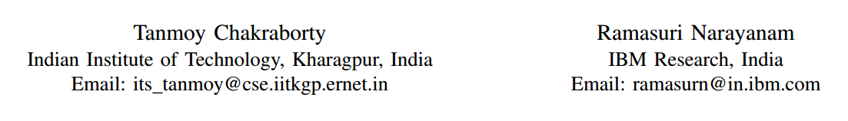
Cross-layer Betweenness Centrality in Multiplex Networks with Applications
ICDE 2016
Tianzhu Wei
2016/9/13

Slide 2
Contents
Preparation & Problem definition
Exist solution
Our solution
Experiments & Applications
Conclusion

Slide 3
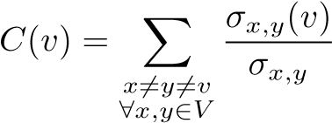
Betweenness centrality
quantify the relative importance of a vertex
Informally
h
f
More formally
a
c
g
i
b
d
e
σ _{x,y} is the number of shortest paths between x and y
σ _{x,y} (v) is the number of shortest paths between x and y that pass through vertex v
Notes:
中介中心性：如果两个不相邻的参与者 k 和 j 想要与对方互动而参与者i处在它们的路径上，那么i可能对它们之间的互动拥有一定的控制力。中介性用来度量i对于其他结点的控制能力。即如果i处在非常多结点的交互路径上，那么i就是一个重要的参与者。
反映了节点v作为“桥梁”的重要程度

Slide 4
Multiplex networks
. . . .
simple networks
a
c
FaceBook
b
h
f
a
c
g
i
b
d
e
a
c
Twitter
b
the vertices are connected by a single interaction type or layer
Betweenness centrality
Cross-layer Betweenness Centrality
Notes:
多重网络由一个三元组组成
An example of a multiplex network is online social networks where the same individuals interact with others through various forms of social media such as Facebook, LinkedIn, and Twitter .

Slide 5
Contents
Preparation & Problem definition
Exist solution
Our solution
Experiments & Applications
Conclusion

Slide 6
Exist solution
Approach 1
h
f
a
c
g
i
b
d
e
C(a) = C(b) = C(c)
h
f
a
c
g
i
b
d
e
Notes:
Different layers in the multiplex network are projected into a single layer to form an aggregated simple network and the metrics are computed over this aggregated network

Slide 7

Exist solution
Approach 2
h
f
a
c
g
i
b
d
e
$$+$$
h
f
C(a) = C(b) = C(c)
a
c
g
i
b
d
e
Notes:
: Each layer is treated independently in terms of evaluating the metrics and then these layerwise results are aggregated later in multiple ways

Slide 8
Exist solution
Approach 3 The computation of metrics in multiplex networks is performed directly by taking into account the effects of the interdependencies among the layers

Slide 9
Contents
Preparation & Problem definition
Exist solution
Our solution
Experiments & Applications
Conclusion

Slide 10
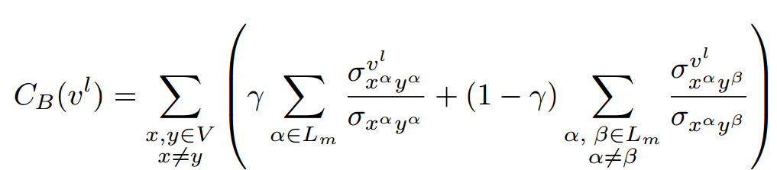
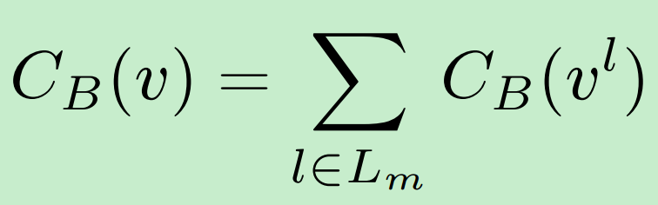
Our Solution
Layer 1
a
c
b
Layer 2
a
c
b

Slide 11
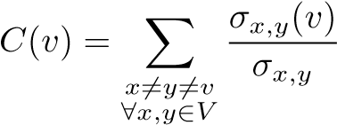
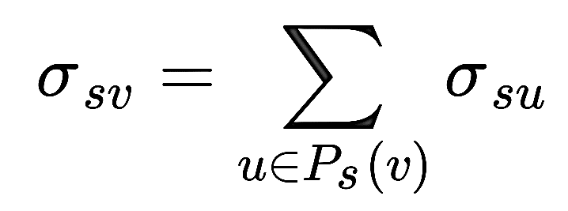
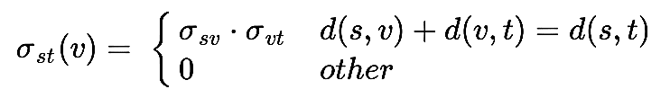


我们可以这样计算 $σx,y\left(v\right) 但是作者为我们提供了更好的方法$
A FASTER ALGORITHMFOR BETWEENNES SCENTRALITY
要选中一个起始顶点
Our Solution
simple networks
1. Compute $σx,y$
u
2. Compute $σx,y(v)$
s
u
v
d
b
s
v
u
t
e
a
f
c
i
Notes:
节点 s 到节点 v 的最短路径中 v 的前驱节点集
无权图调用BFS算法
注意$σ$为最短路径的个数
简单介绍下BFS为什么可以做。我们知道BFS遍历节点的顺序恰好是按照距离节点s的距离升序排列的，而节点u是v的前驱节点必然要求d(s,u)<d(s,v),因此按照BFS遍历顺序，到达节点v时，其前驱节点u的σ_{su}必然已经计算好了。

Slide 12
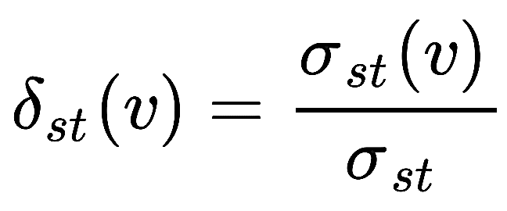
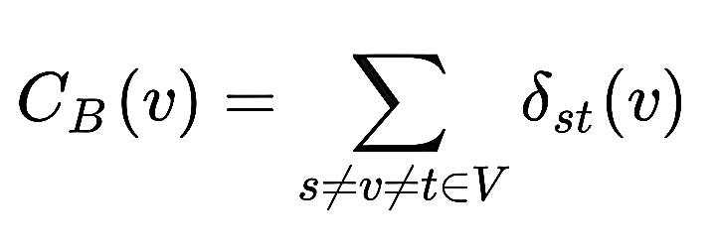
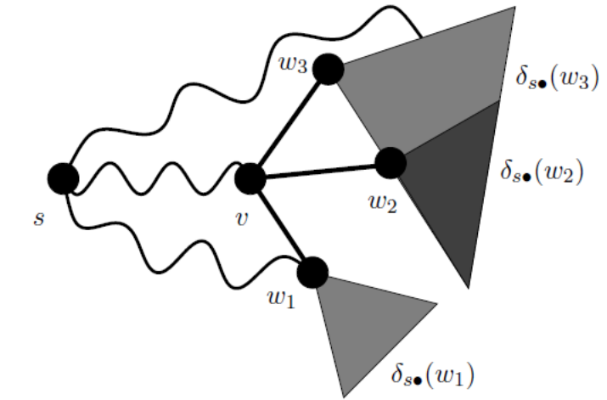
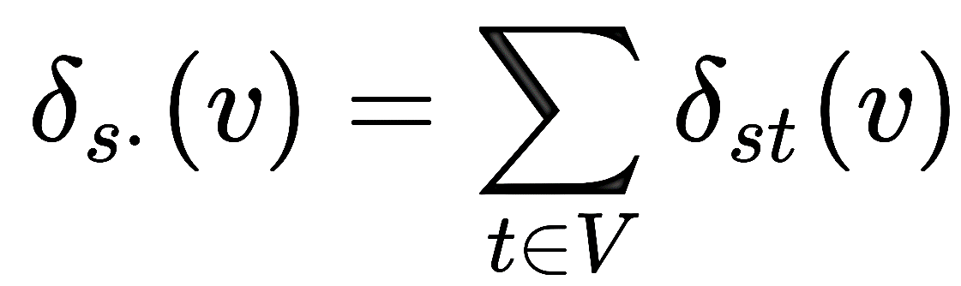
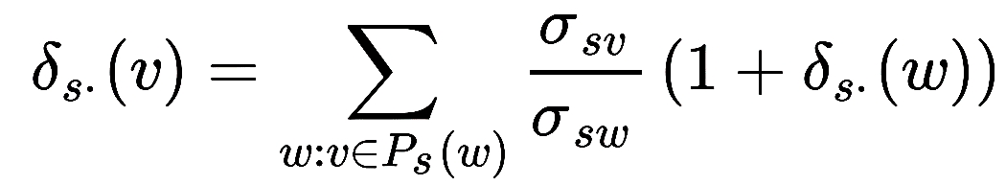
Our Solution
Define :
Define :

Slide 13
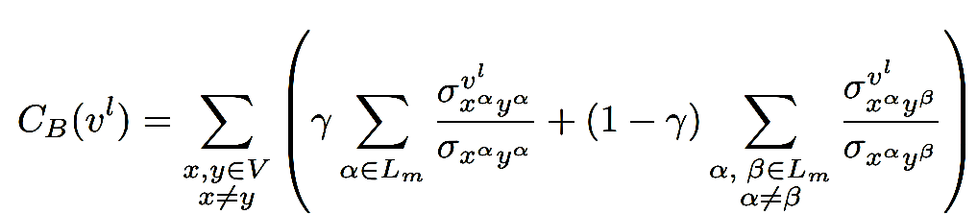
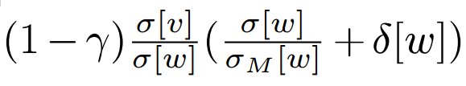

Our Solution
Layer 1
1
6
Multiplex degeneracy of a vertex
h
f
3
5
7
2
a
4
c
BFS
ie. Start from a
g
i
b
Q
8
9
f15
c5
c14
h10
b4
i2
h1
d
e
Layer 2
10
15
h
12
14
f
a
16
11
13
c
g
i
b
17
18
d
e
随便选中一个顶点开始，假设从 a 开始
对每一层的 a 都进行广度优先遍历（BFS）并且放入一个队列之中
遍历完成之后再从队列依次取出 a ，并且将与 a 相邻的结点放入队列
直至这个队列为空了，停止这个循环
Notes:
BFS遍历节点

Slide 14
Contents
Preparation & Problem definition
Exist solution
Our solution
Experiments & Applications
Conclusion

Slide 15
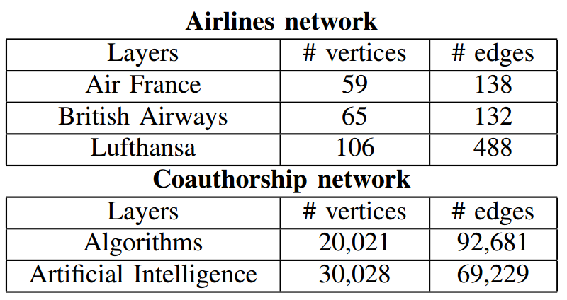
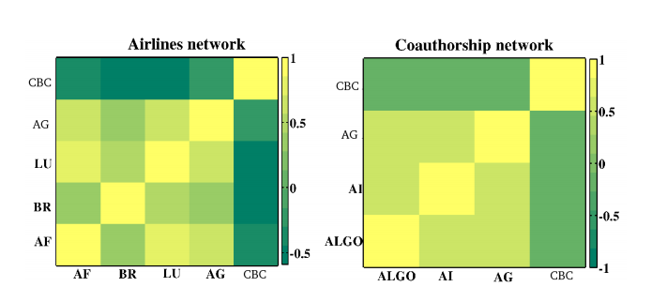
Experiments
Kendall rank correlation coefficient τ is a statistic used to measure the association between two measured quantities.
CBC
CBC
AG
AG
LU
AI
BA
AF
ALGO
AF
BA
LU
AG
CBC
ALGO
AI
AG
CBC
Notes:
1. vertices represent airports, while links stand for direct flights between two airports
2. Here vertices correspond to authors and edges represent collaborations between pair-wise authors if they collaborate at least once in a paper
3. we can conclude that the betweenness centrality provided by aggregated method is usually different than the CBC-based method

Slide 16
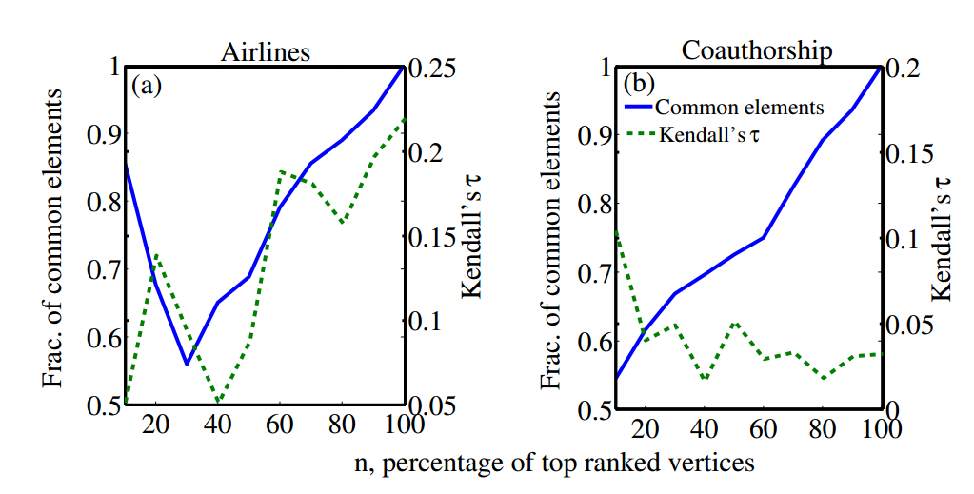
Experiments

Slide 17
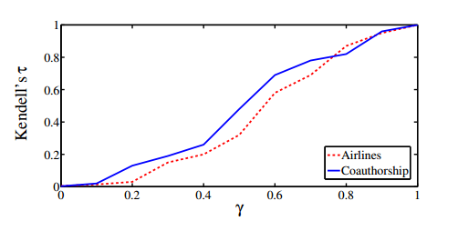
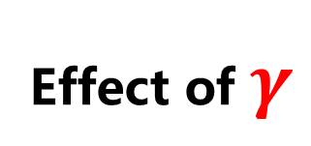
Experiments
Effect of $γ$

Slide 18
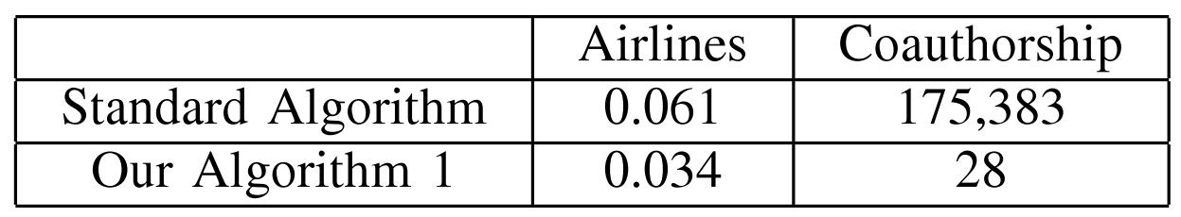
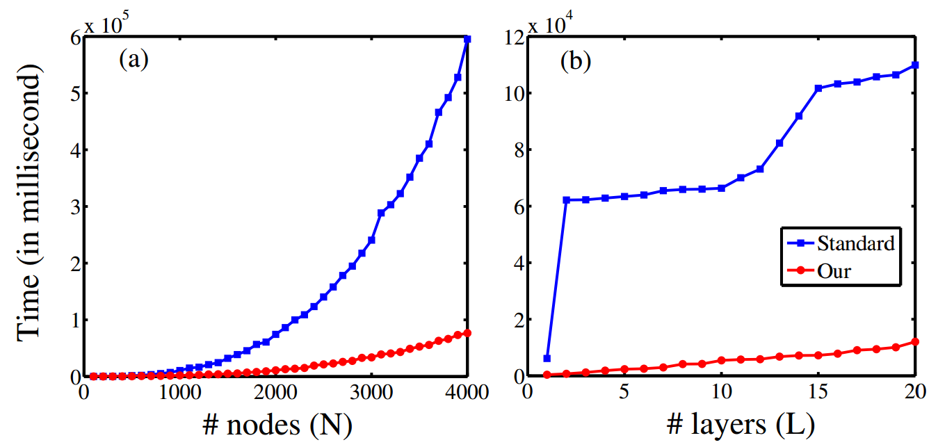
Experiments
Runing Times
O(N³L³)
O(NLE)
Notes:
Standard Algorithm : The naive computation of the proposed centrality measure takes O(N³L³) time

Slide 19
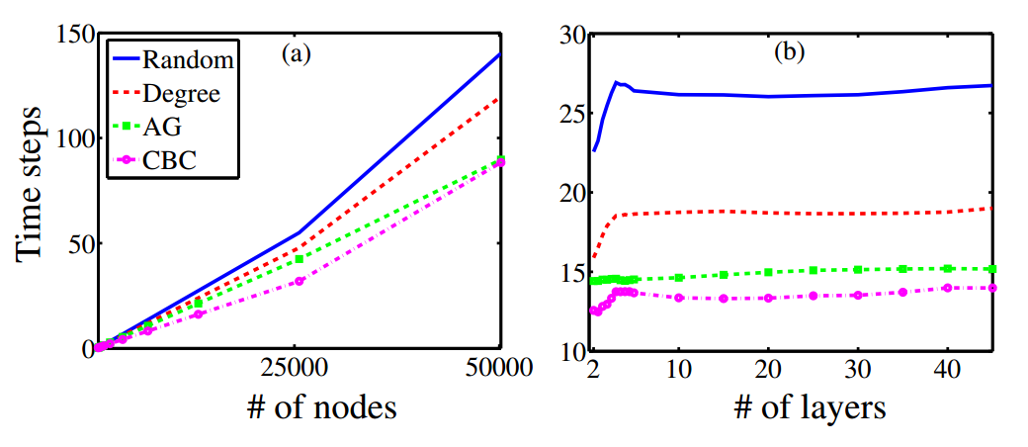
Appications
Initiator Selection for Message Spreading
Notes:
消息传播初始点选取：选取一个初始点集合，将消息传播给与自己相连接的结点，然后再继续扩散，直至每一个结点都收到消息。
之前方法是 1 随机 2按度排序
现在作者提出按 中介中心性 的方法来进行

Slide 20
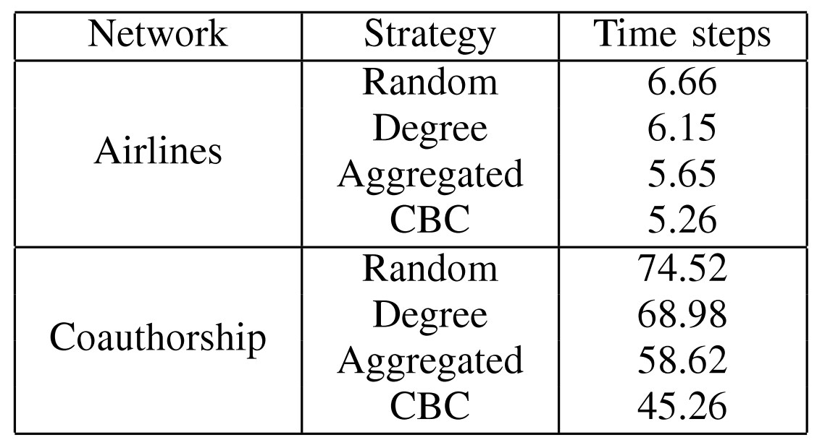
Appications
Initiator Selection for Message Spreading

Slide 21
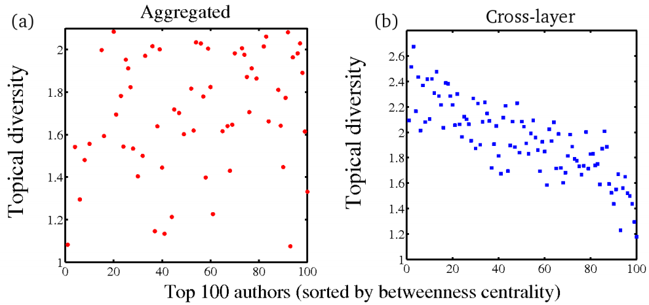
Appications
Finding Interdisciplinary Authors
作者说这个图从侧面证明了CBC的准确性在这个 Coauthorship数据集中
Notes:
科技界的作者越来越从事更多的领域，从事更多领域的人通常扮演着桥梁的作用（像之前提到的图中的B结点一样），从而他的中介中心性也就越大，并且控制着信息的流动在他所从事的几个领域，
根据 跨层之间的相关性 中介中心性值来评估作者 跨学科的重要性 越重要
在合著网络丰富的元数据信息进一步使我们能够研究跨学科的作者。
作者有越多的研究主题研究，则他的影响越大跨学科

Slide 22
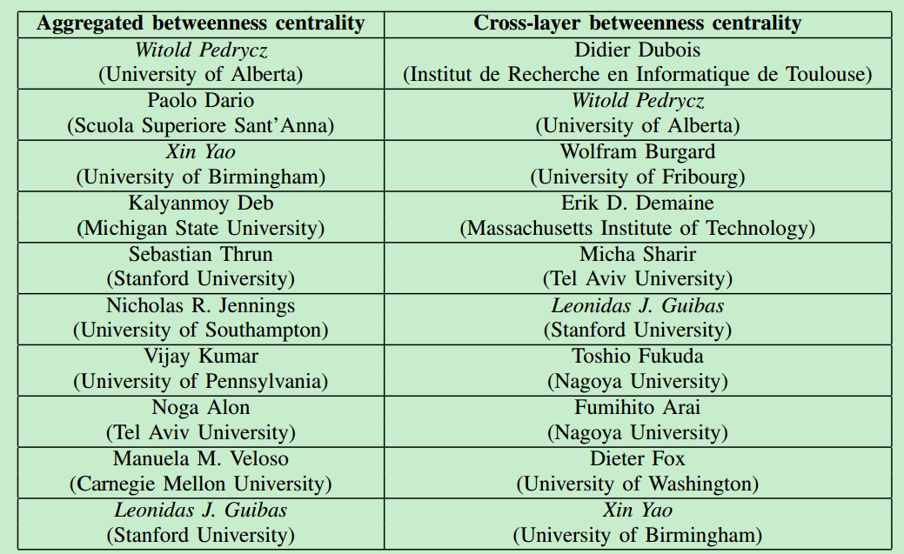
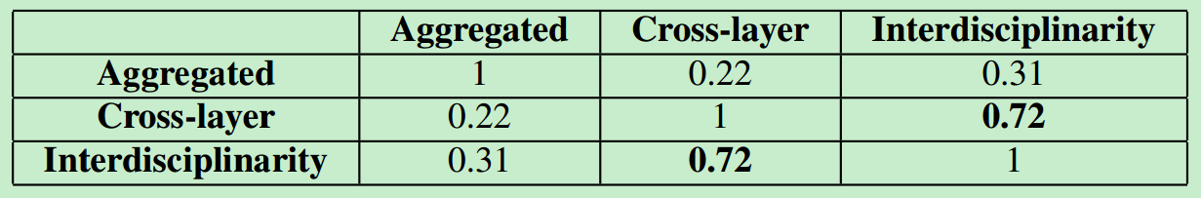
Appications
Finding Interdisciplinary Authors
展现出我们 CBC更加准确

Slide 23
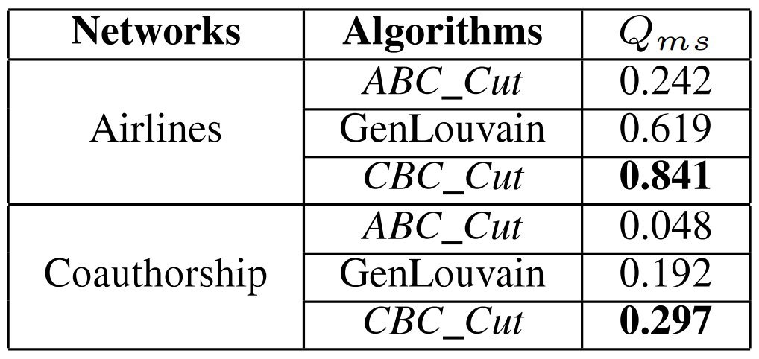
Appications
the vertices in the network can be easily grouped into sets of vertices such that each set of vertices is densely connected internally
Community Detection in Multiplex Networks

Slide 24
Contents
Preparation & Problem definition
Exist solution
Our solution
Experiments & Applications
Conclusion

Slide 25
Conclusion
Betweenness centrality
Simple Networks
Cross-layer Betweenness centrality
Multiplex Networks
Initiator Selection for Message Spreading
Appications
Finding Interdisciplinary Authors
Community Detection in Multiplex Networks

Slide 26
Thanks

